Slide 1

WELCOME!
To The
The FiSH! Philosophy
FiSH! 101: Boosting Engagement, Energy,
and Accountability in Transit Leadership
Notes:
Consider having fun music playing as participants enter the call/room.

Slide 2
Session Goals
By the end of this session, you will:
Understand the four core principles of the FiSH! Philosophy
Explore how these principles can energize transit teams
Discuss real-world applications for finance and leadership roles
Leave with actionable ideas to improve morale, service, and communication

Slide 3
Why FiSH! for Transit Leaders?
Finance and transit teams are essential but often undervalued.
Culture and morale directly affect service and accountability.
FiSH! is a practical framework to:
  Build stronger teams
  Reduce burnout
  Strengthen communication and trust

Slide 4
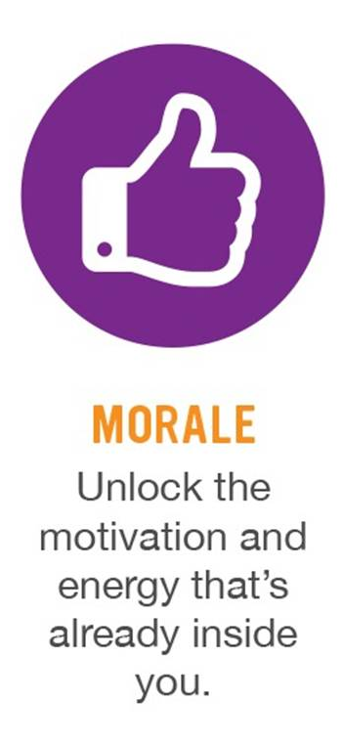
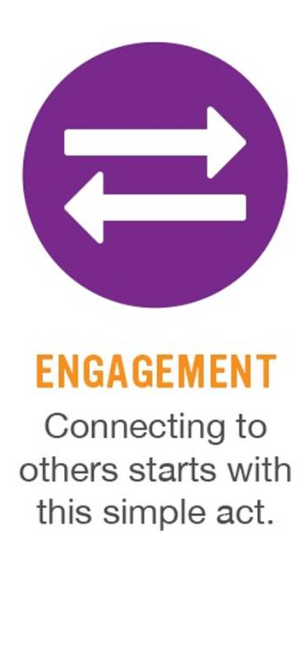
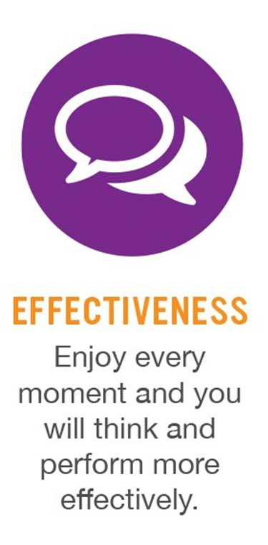

The Benefits of FiSH!

Slide 5








The FiSH! Philosophy Practices

Slide 6
Notes:
We cannot control everything — but we can control how we show up.
Attitude is contagious, especially in leadership.
In Transit Finance:
During budget season, choose calm and focus instead of frustration.
In front of your board or staff, model resilience and optimism.

Slide 7
Choose your attitude:
No matter what life throws in your path, you alone are responsible for how you respond to it.
Notes:
The only thing you really have control over is how you respond to the things life throws at you.
The guys are not working in an “ideal” setting. It’s cold, often rainy, REALLY early in the morning, stinky, competition is everywhere!
Not only do we get to choose, but we should also recognize our impact with our attitudes.
Attitudes are contagious.
There is no correct attitude for every situation. There are times when it’s appropriate/OK to be angry or sad.
Just BE AWARE that you are choosing.

Slide 8

Become aware
Make a conscious choice and recognize impact
Live in alignment with your intentions

Slide 9


IT’S A SIMPLE CHOICE:
Consciously choose how you show up

Slide 10
Changing Your Mindset
Incorporating Positive Language: Replace “We Can’t” with “How Can We”, “Won’t work” with “How Will It”. “Yes, but” with “Yes and”
Incorporating “Magic Words”: Definitely, Surely, Absolutely, Certainly
Incorporating Empathy: I understand why you are upset, I would be too if I were in your situation…
Incorporate Can-Do Language: I understand you want XYZ, this is what I CAN DO for you….

Slide 11
Reflection…
Think about situations where it might be challenging to choose the appropriate attitude.

Slide 12
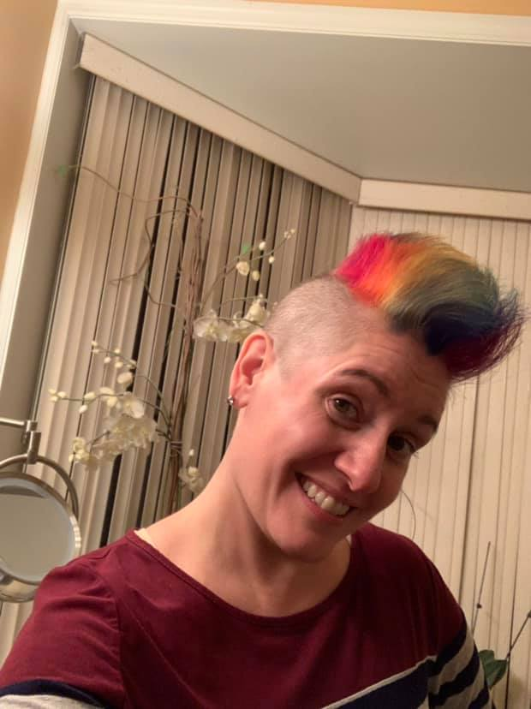

Slide 13
Choose Your Attitude & The Other Practices
You can’t “Be There” for someone or “Make Their Day” if you’ve chosen the wrong attitude…
“It’s Simple Choice”

Slide 14

Notes:
Being fully present builds trust.
Listening makes people feel valued.
Leadership presence = attention and care.
Transit Example: When finance leaders take time to listen to a frontline employee’s concern, that employee feels seen and supported.

Slide 15
Be There:
Be physically and emotionally present for people, especially when they need you. It’s a powerful message of respect that strengthens relationships.

Slide 16
Being FULLY present
          Physically AND Emotionally
Listening to UNDERSTAND, not just reply
Taking action based on awareness

Slide 17
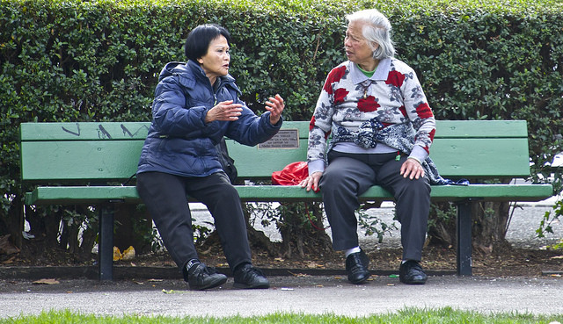
Be There/Not Be There
Volunteers? (I need two of you…)
Notes:
For VIRTUAL class, ask for 2 volunteers.
Have first volunteer speak so everyone can see them (ask participants to be in Zoom “Gallery Mode” if possible.
Ask Volunteer 1 to do everything they can to NOT BE THERE for you. Share a personal story with volunteer 1 for 1 minute. Discuss how volunteer 1 was not there for you. Significance? In person and on screen, we need to be there for others.
Ask Volunteer 2 to be there for you. Share another story for 1 minute. Discuss the difference and how V2 was there. What did he/she do to convey Be There?

Slide 18
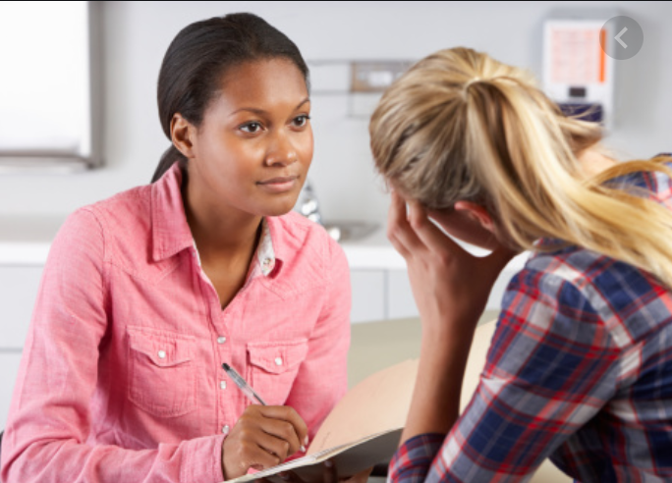
Be There Story
Write down your answers to:
What color was the forest?
What color was my backpack?
What color was my blanket?
Whose blanket was it?
What kind of bottle did I have?
What color was it?
Why do you think I should I have known better?
Describe the man’s face.
What kind of magazine did he have?
Notes:
Tell participants you came across something you want to share:
I was walking through the dark green forest carrying my favorite blue bag. I pulled out my moms old purple blanket and laid it down on the cold brown ground. I sat down and pulled out my pink wine bottle, I knew better. After a few hours I felt dizzy and lightheaded. I saw a man with a creepy looking beige face walking toward me. He pulled out a grey dirty magazine and asked to sit next to me.
What color was the forest?
What color was my bag?
What color was my blanket?
Whose blanket was it?
What kind of bottle did I have?
What color was it?
Why do you think I should I have known better?
Describe the mans face.
What kind of magazine did he have?
Some details are exact and straightforward - like the colors
Some details you have to read between the lines - I sat down and pulled out my pink wine bottle, I knew better.
Some you need to ask clarifying questions - He pulled out a grey dirty magazine and asked to sit next to me.
When we are not THERE or fully present we tend to miss details that could be important for work - project, timeline, event etc.
OR personally we can miss a person that needs us because they are having a hard time but don’t come out directly and say it.

Slide 19
Be There Story
Forest: Dark Green
Backpack: Blue
Mom’s Blanket: Purple
Bottle: Wine Bottle
Bottle Color: Green?
Should have known not to drink too much wine in the middle of a hike
Mans’ Face: Creepy and Beige
Magazine: Covered with dried mud…
When we are not “There” for someone, we miss stuff…
Like details or opportunities to help
Notes:
Some details are exact and straightforward - like the colors
Some details you have to read between the lines - I sat down and pulled out my pink wine bottle, I knew better.
Some you need to ask clarifying questions - He pulled out a grey dirty magazine and asked to sit next to me.
When we are not THERE or fully present we tend to miss details that could be important for work - project, timeline, event etc.
OR personally we can miss a person that needs us because they are having a hard time but don’t come out directly and say it.

Slide 20
Summary…
Show up – Care About Them – Be on Their Team
Determine what they need/want – ASK!
Respond Quickly – Resolve as soon as you can
Make them feel welcome, not just invited
Enjoy Serving them

Slide 21
Reflection…
Think about how you might “Be There” for your Customers and each other…

Slide 22
Notes:
Small gestures can create lasting impact.
Leaders can shape someone’s shift — or their week.
Transit Example: Payroll or procurement teams surprising operators with small tokens of appreciation, or sending a quick note of thanks when someone goes above and beyond.

Slide 23

Notes:
Who doesn’t love a cute puppy? I hope I just made someone’s day with this image! (Maybe change the image out to one that makes your day)
Ask for volunteers to explain what Make Their Day means to them. How does it make them feel

Slide 24
Make Their Day
Find ways to make people feel special, letting (and let) them know how much you value and appreciate them. Celebrate others.

Slide 25
An Example…
Value and recognize others
Be genuinely selfless
Be aware of who needs their day
made and how they like to have it
made
Selflessly delighting and valuing
others

Slide 26
Make Their Day & Being There
You have to “Be There” for someone in order to “Make Their Day”
The Platinum Rule: Treat others how THEY want to be treated
  It’s not about what might make YOUR day…

Slide 27
What do you like to be recognized FOR?
Notes:
Ask participants what they like to be recognized for.
Often, we think people want to be rewarded with cash, but many studies show that money rewards/recognition lose their effectiveness. Sometimes people just want words of recognition!

Slide 28
Make their day:
HOW do you like to be recognized?

Slide 29
Make Their Day Ideas
Highlight them in your social media posts
Random notes of Thanks
Show that you care about them
  Look at issues from their perspective
  Be on their team
  Incorporate “We” Language into dialogue
Defeat the problem not the person
Notes:
DEFINITION (can be found on page 13 of Participant’s Workbook)

Slide 30
Reflection…
Think about how you might
“Make Their Day”
For your Customers and others…

Slide 31

Notes:
Play means bringing creativity, curiosity, and lightness.
Even in high-pressure, budget-driven environments, play is possible.
For Finance Teams, “Play” might look like:
Friendly contests for process improvement ideas
Recognizing one another in creative ways
Starting meetings with a quick energizer or story

Slide 32
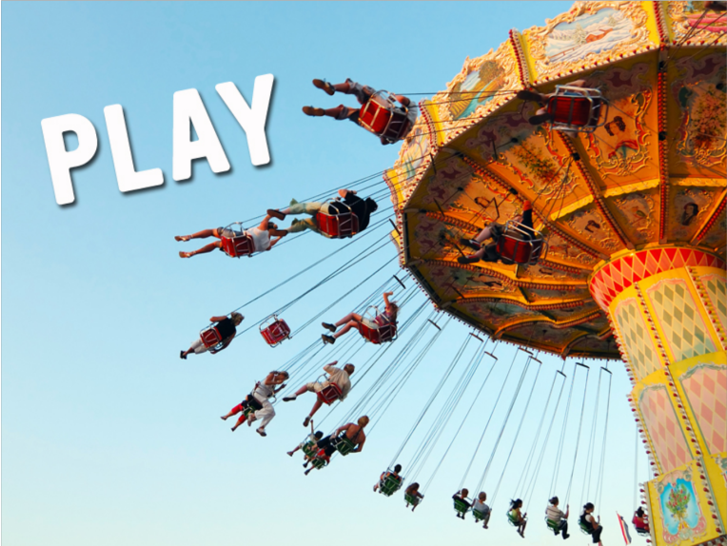
play:
Play is a state of mind that you can apply to any task. It’s the spirit that fuels creativity, as in “Let’s Play with that idea!” You do your best work when you are having fun doing it.
Notes:
Slide 6 – Principle 2: Play
Play means bringing creativity, curiosity, and lightness.
Even in high-pressure, budget-driven environments, play is possible.
For Finance Teams, “Play” might look like:
Friendly contests for process improvement ideas
Recognizing one another in creative ways
Starting meetings with a quick energizer or story

Slide 33
Play Encourages Creativity Through;
Curiosity
Freedom to innovate
Freedom to be you
Trust and Playing Field
Environment
Notes:
PLAY is defined on Page 9 in Participants Workbook
Curiosity: Play is the spirit that drives a curious mind – great ideas come to us when our minds are unfocused
Freedom to innovate: Feeling safe to create, make mistakes and learn (safety to throw out crazy ideas, think about things differently, come up with new solutions)
Freedom to be you: natural, lighthearted, friendly, spontaneous, helpful
Trust and the Playing Field: mutual agreement about boundaries
Environment: how it inspires creativity for you and your team (ping pong tables, whiteboards everywhere, beer on tap, etc)
Discussion: How did Play show up in the film?
What do you do now that is playful (relate back to the points above when possible)

Slide 34
Applying FiSH! in Transit & Finance
FiSH! principles can help with:
Retention and Morale – keeping employees engaged in difficult roles
Cross-Department Communication – reducing silos between finance and operations
Culture-Building – strengthening shared values across dispersed teams
Case Question: What would “Be There” look like in your department?

Slide 35
Guided Exercise
“Which FiSH! principle does your team need the most right now — and why?”
Discuss in small groups
Be ready to share 1–2 real examples of “Make Their Day” or “Choose Your Attitude” in finance teams

Slide 36

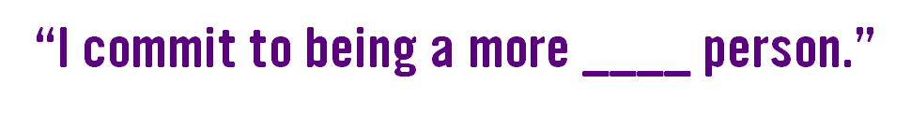
Take your Commitment Statement,
crumble it into a ball….

Slide 37
SNOWBALL FIGHT!
Now that it’s over....
Pick up the nearest commitment “Snowball” and read it.
What did you just learn about someone else in the group?

Slide 38
The FISH! Philosophy Practices
One word reflection….
Notes:
Have attendees name the 4 practices
Emphasize that we refer to these as “PRACTICES”
Just like learning to play the piano or learning anything new, you have to practice – it requires action
And the more you do it, the better you become. To keep FISH! alive in your life, practice, practice, practice.
EXAMPLE: If you want to lose weight, you can’t expect to lose 9 lbs by going to the gym on Monday. You need to continually do the work until you see results. Even though everyone’s results may be different, you know, 100%, that you will see results.

Slide 39
The FISH! Philosophy Practices
THANK YOU! Rebecca.bandbhr@gmail.com
Notes:
Have attendees name the 4 practices
Emphasize that we refer to these as “PRACTICES”
Just like learning to play the piano or learning anything new, you have to practice – it requires action
And the more you do it, the better you become. To keep FISH! alive in your life, practice, practice, practice.
EXAMPLE: If you want to lose weight, you can’t expect to lose 9 lbs by going to the gym on Monday. You need to continually do the work until you see results. Even though everyone’s results may be different, you know, 100%, that you will see results.

